Slide 1
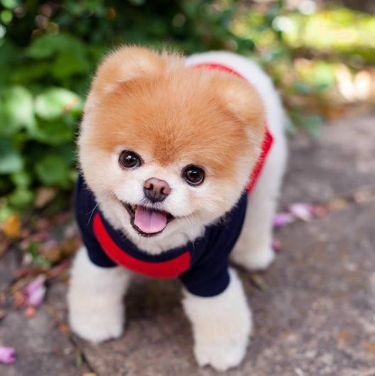
Milestone 4 ECS 165A

Slide 2
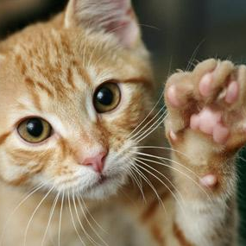
HIJK Team
Hanxing Zhang
Isabella Pitco
Jennifer Ly
Kauana dos Santos

Slide 3
1.
Hashtags
Search for posts by its hashtags.

Slide 4

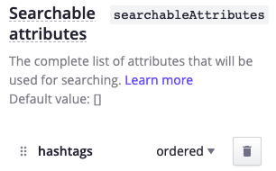
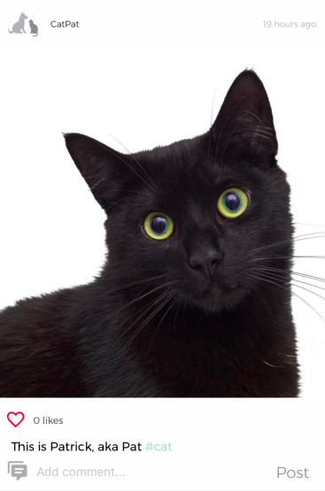
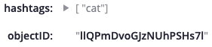
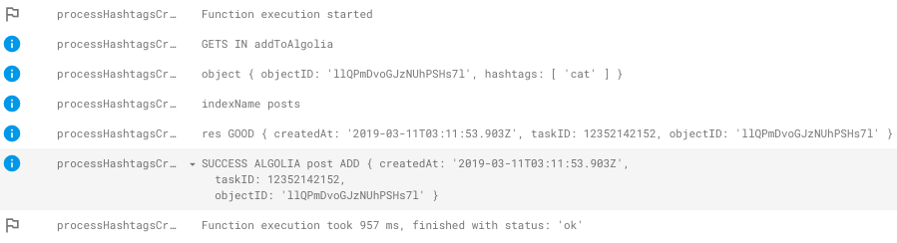
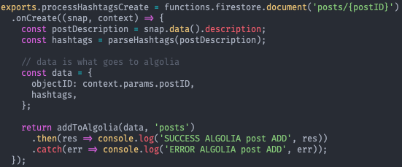
Hashtags Implementation:
Algolia side:
Front-end post:
Cloud function (create):

Slide 5
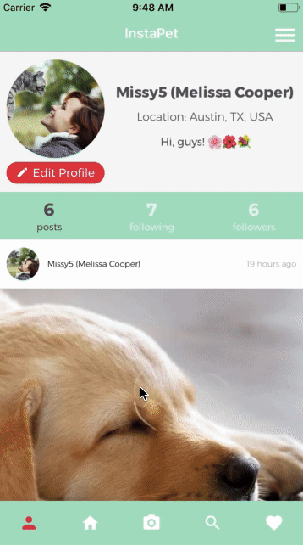
Find similar posts by their hashtag.
Hashtags are highlighted and clickable. Clicking them is the same as searching posts based on the clicked hashtag.
Users can also manually search by hashtags in the search screen.

Slide 6
2.
Notifications
Send notifications for key events.

Slide 7
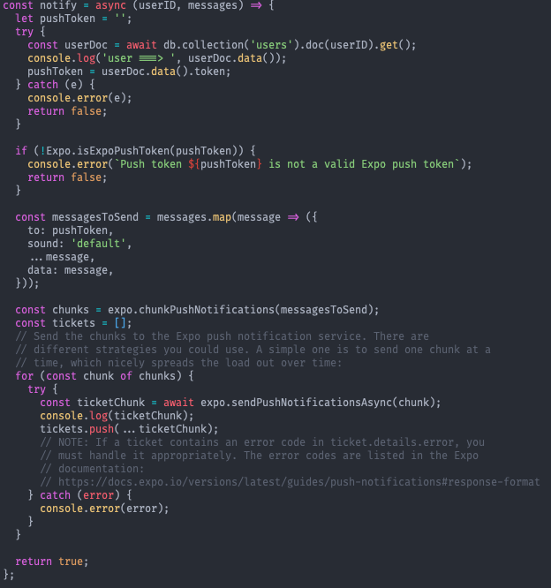
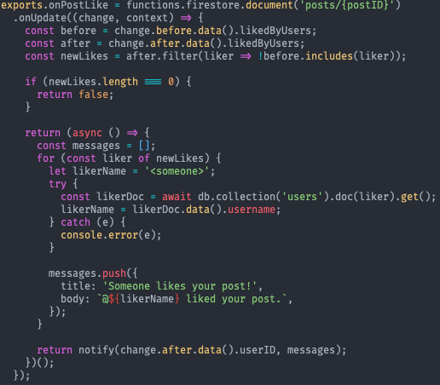
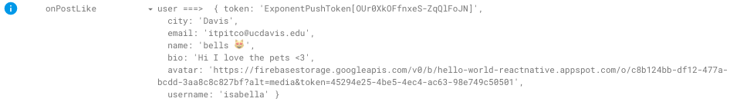
Notifications Implementation
More cloud functions!
Helper function:
On firebase console:

Slide 8
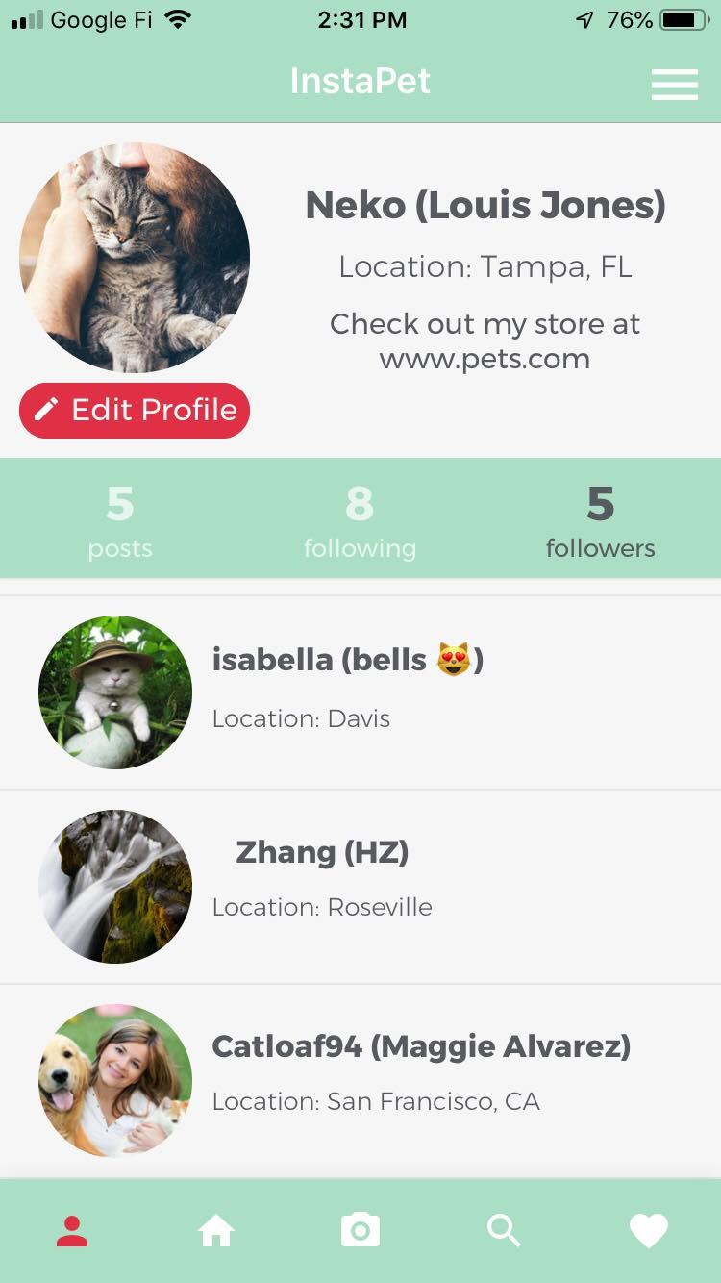
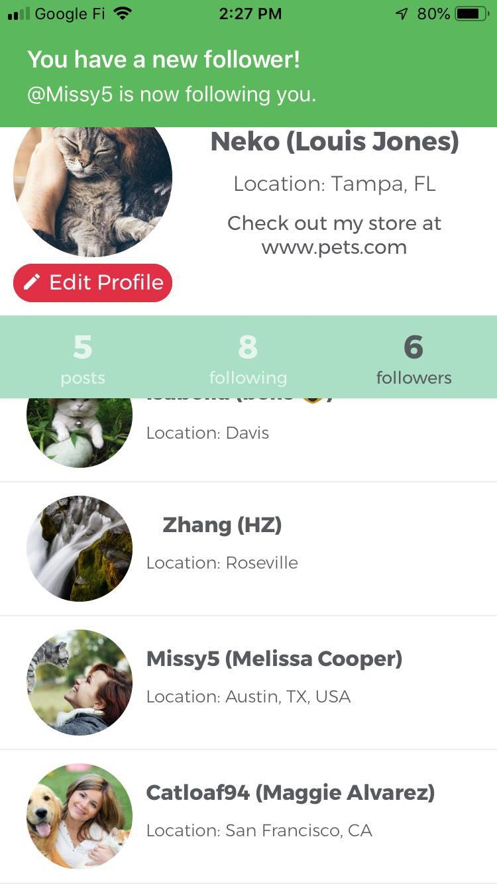
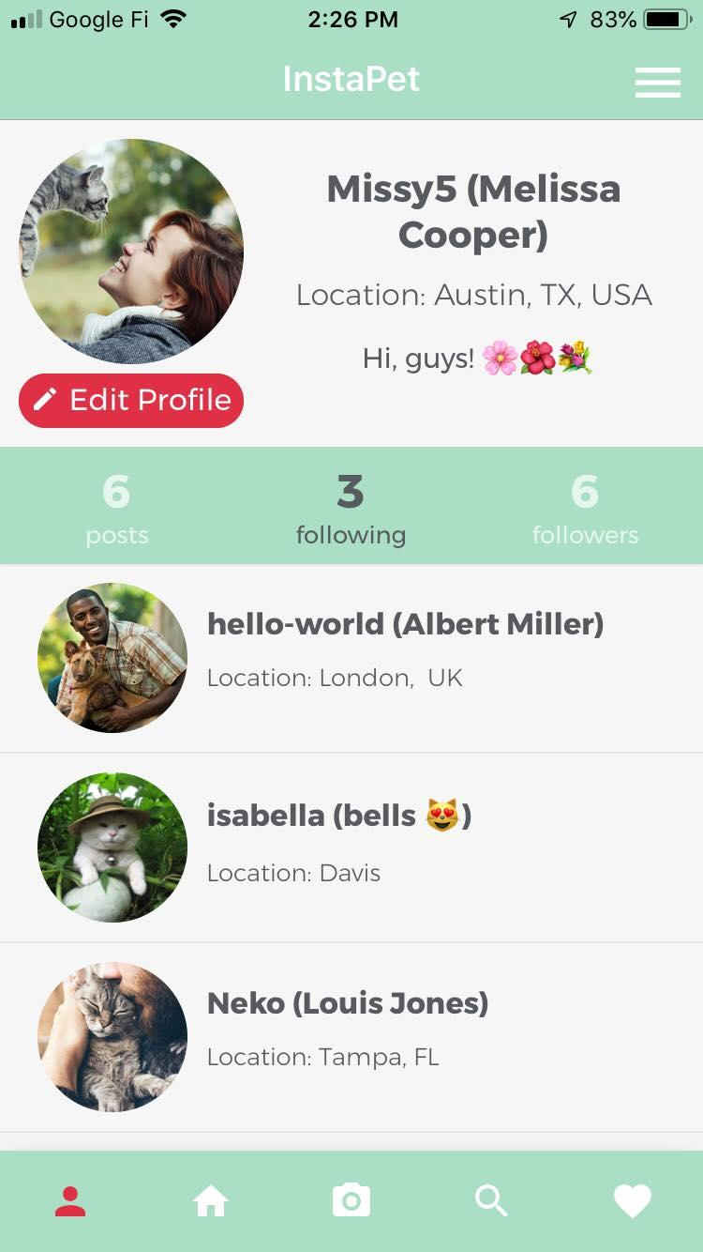
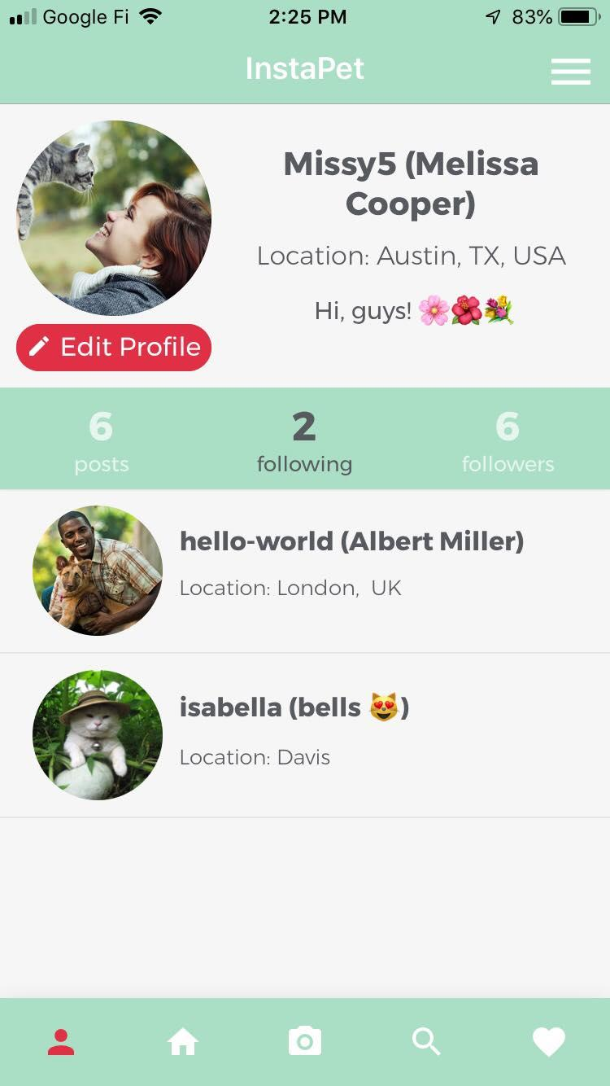
Missy5
Neko
New Followers
Place your screenshot here
Place your screenshot here
1) Missy5 follows Neko.
2) Neko receives Expo notification.

Slide 9
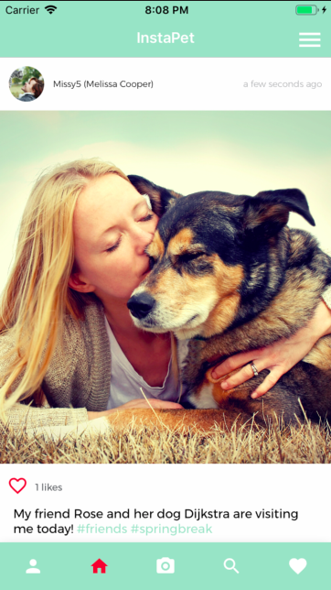

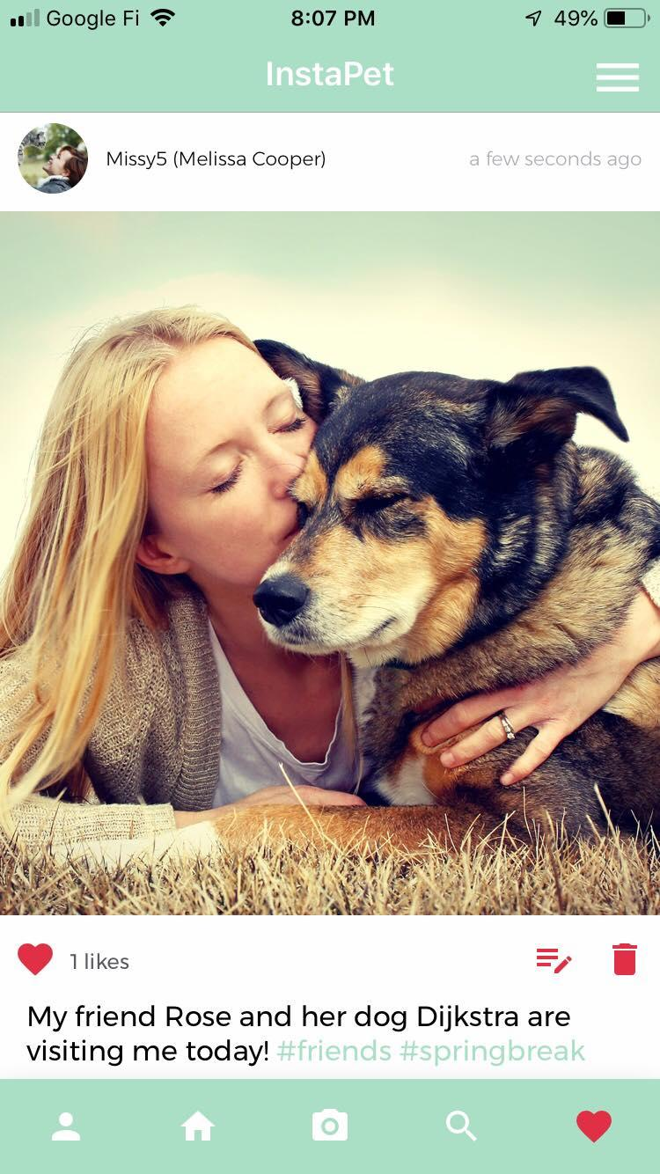
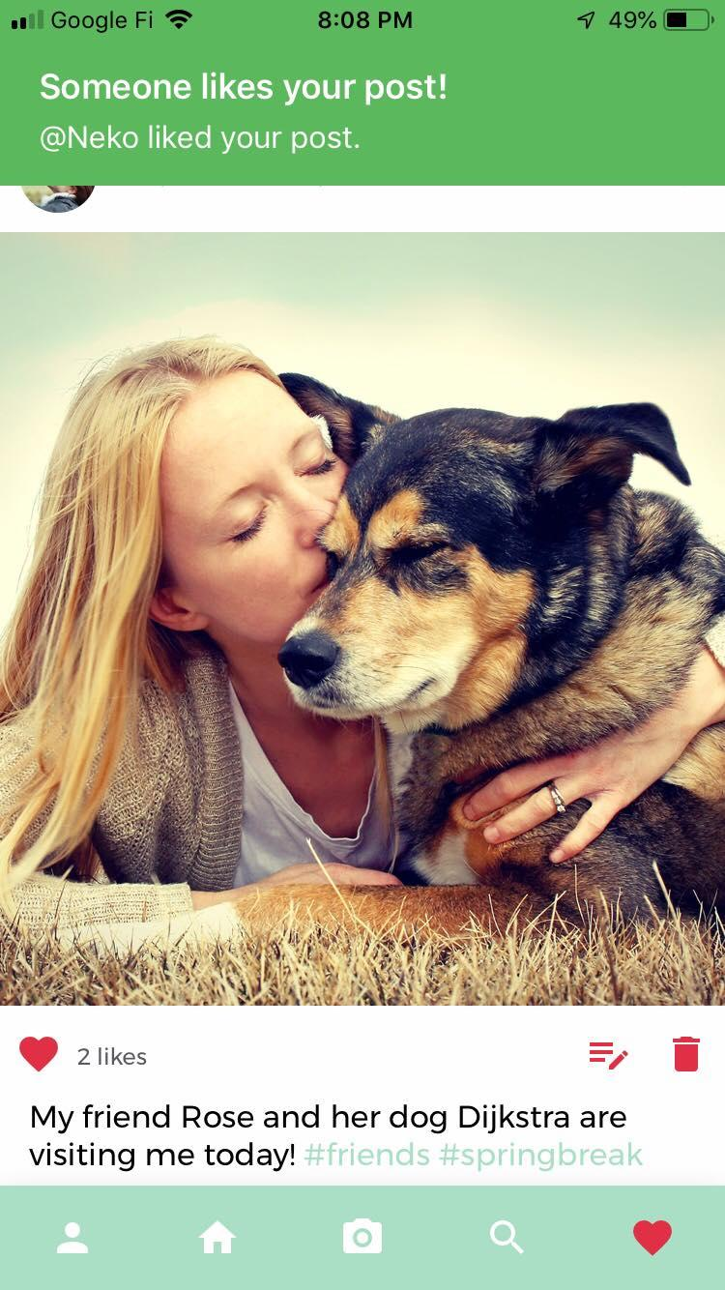
Missy5
Neko
Neko
New Likes
Place your screenshot here
Place your screenshot here
1) Neko likes Missy5’s post.
2) Missy5 receives Expo notification.

Slide 10
3.
Additional Features
Implemented since last milestone.

Slide 11
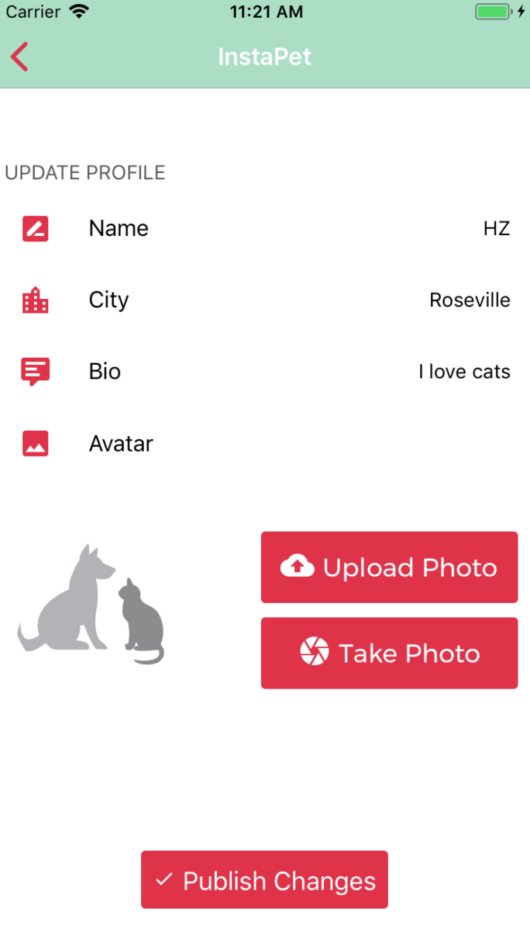
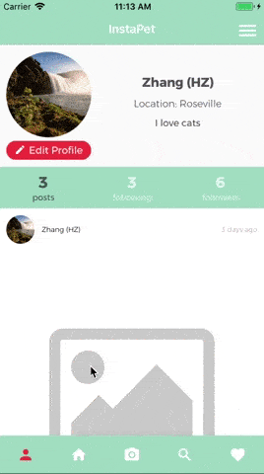
Profile Picture: Take Photo or Upload Photo
Before: users had to add a picture URL.
Now: users can upload a photo or take a photo.
Place your screenshot here
Place your screenshot here

Slide 12
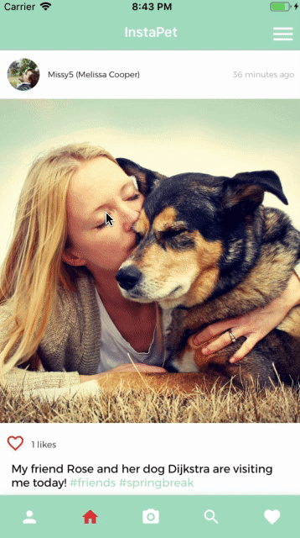
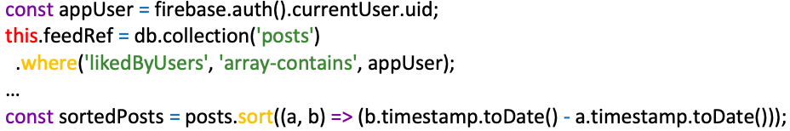
Favorite Screen: Posts the app user liked by timestamp
where clause gets all posts the user liked
Sort the posts by timestamp before displaying them
Place your screenshot here

Slide 13
4.
Future Work
Extra features we would like to add next.

Slide 14
Future Work
Supporting reply to each individual comment.
Suggest users who to follow when a new user signs up
Use the number of followers as a metric to select the most popular people on the App.
For the feed maintenance algorithm, choose posts from other users the current user interacts with more often.
Allow users to reset password if they forgot their password.

Slide 15
5.
UI/UX Design vs. Actual Implementation

Slide 16
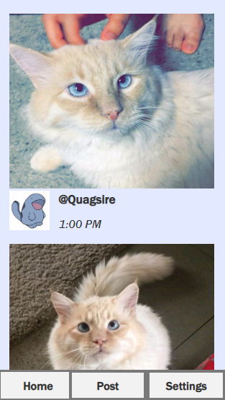
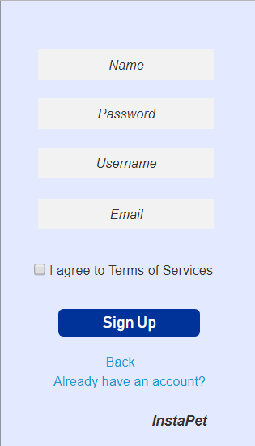
Initial Mockups

Slide 17
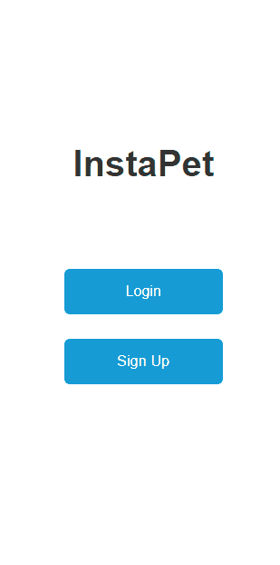

UX Wireframes and UI Design

Slide 18
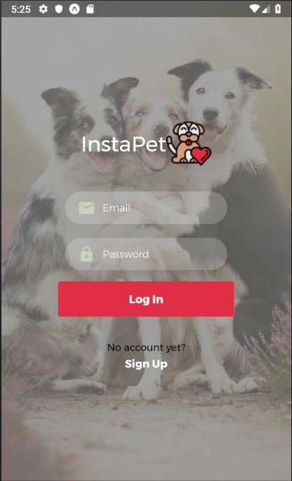
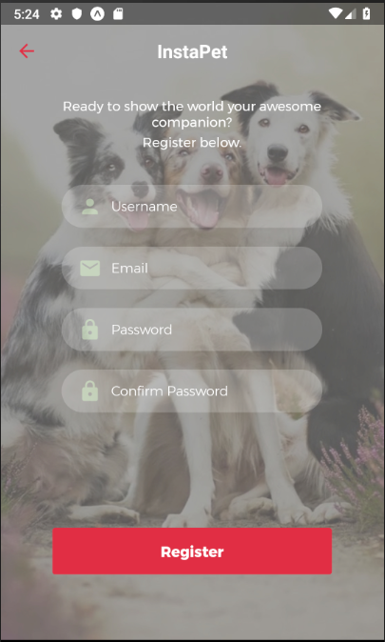
Final Design: Login & SignUp Screens

Slide 19
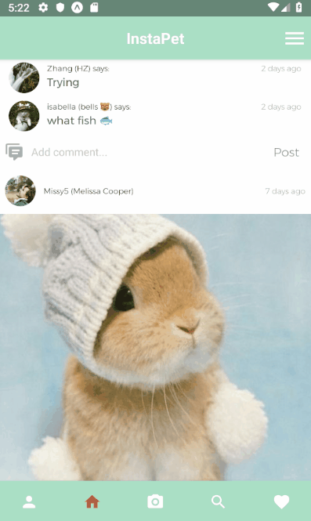
Final Design App Functions

Slide 20
6.
App Demo
Hashtags, new follower/likes notification, favorite posts and edit profile avatar picture.

Slide 21
Instapet on Expo
If you would like to use our Instapet, our app is published on Expo. To access it open: https://expo.io/@kauana/instapet
Make sure you have the Expo app installed. Have fun!

Slide 22
Credits
Special thanks to all the people who made and released these awesome resources for free:
Presentation template by SlidesCarnival
Paw icon by Freepik at Flaticon

Slide 23

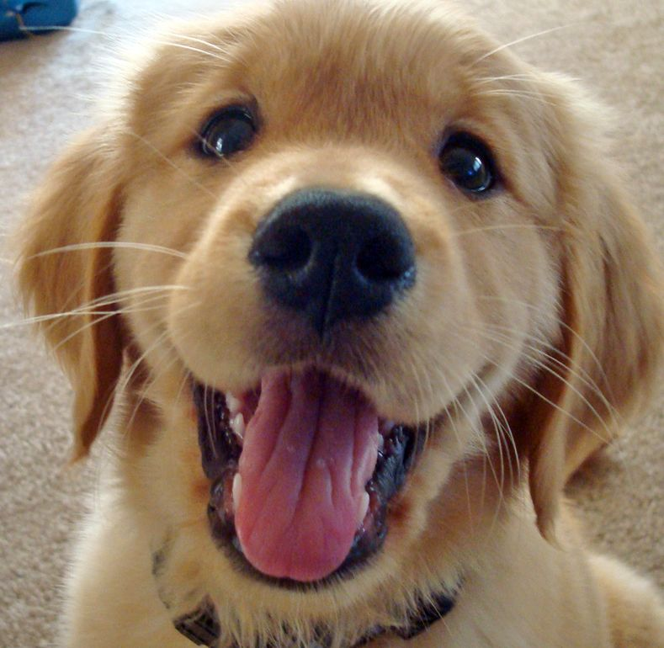
Thanks!
Questions?

